Slide 1
Time-Robust Control for STL Specifications
Presentation by
Aravind S
Aditya Shirwatkar
Vishvaskumar Gajera
Reference: Alëna Rodionova, Lars Lindemann, Manfred Morari, and George J. Pappas. 2021. Time-Robust Control for STL Specifications. In 2021 60th IEEE Conference on Decision and Control (CDC). IEEE Press, 572–579. https://doi.org/10.1109/CDC45484.2021.9683477

Slide 2
Overview
A control framework for time critical systems to satisfy real-time constraints robustly
Use Signal Temporal Logic (STL) to formulate these constraints
Formulate a control problem to find an optimal input sequence that maximizes the time robustness of an STL constraint.
Use Mixed Integer Linear Program (MILP) encoding to enforce those constraints with guarantees.

Slide 3
Introduction

Slide 4

Introduction
Satisfying safety in time-critical systems is a key concern. (Eg. UAV)
Timing uncertainties (eg. incorrect clock synchronization) can compromise real-time constraints.
T1 = 2.15 p.m.
T0 = 2 p.m.

Slide 5
Introduction
Hence, a natural objective is to design a control system to be robust to such timing uncertainties and maximize this robustness.
To formulate real-time constraints, researchers have used real-time temporal logics as a specification formalism such as Metric Temporal Logic (MTL) and Signal Temporal Logic (STL)
This work focuses on the time robustness of STL specifications

Slide 6
Background

Slide 7
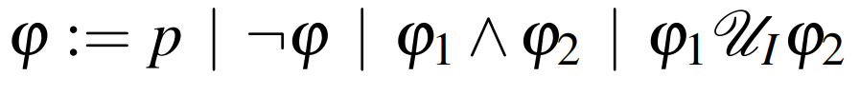

Some Terminologies of STL
Let x : T → X be a discrete time signal, where T ⊆ Z_{≥0} and X ⊆ R^{n}
And a signal at a time step t as x_{t} ∈ X
Let M = {µ₁,...,µ_{L}} be a set of real valued functions µ_{k}(x) : X → R
And for each the corresponding predicate is p_{k} := µ_{k}(x) ≥ 0
Then STL syntax is

Slide 8


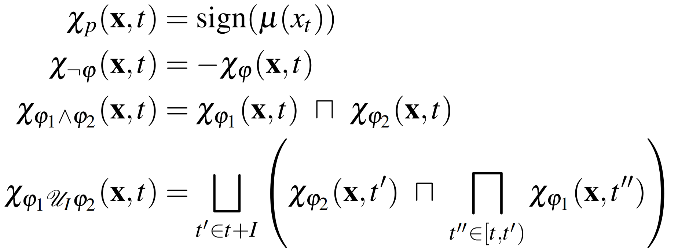
Some Terminologies of STL
Semantics of an STL formula ϕ defines what it means for a system trajectory x at time t
if the satisfaction holds
And if it does not hold
Characteristic function ( χ_{ϕ}(x,t) : X^{T} × T → {−1,+1} ) of an STL formula relative to a trajectory x at time t is defined inductively as:

Slide 9
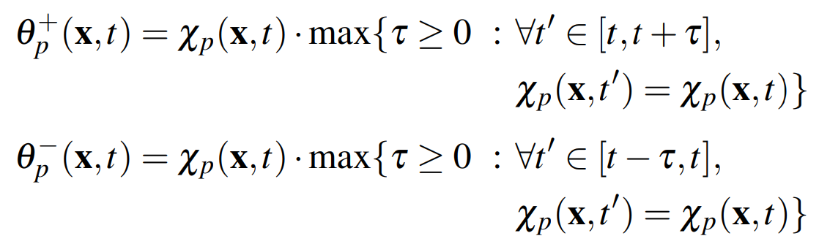

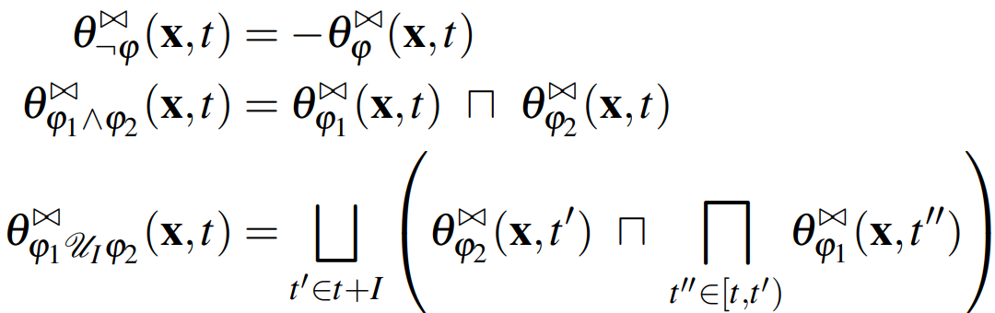
Time Robustness
Right and Left time robustness of an STL formula ϕ with respect to a trajectory x at time t are defined inductively as

Slide 10
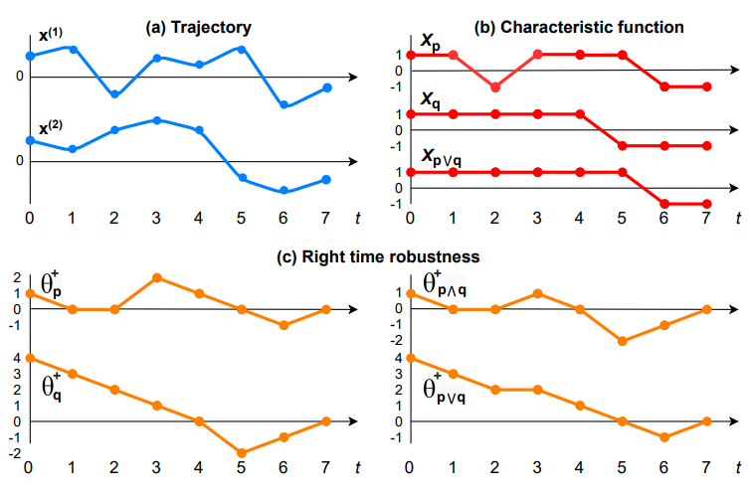
Time Robustness (Example)

Slide 11
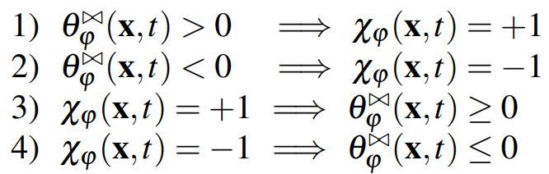


Soundness of Time Robustness
Theorem (Soundness): For an STL formula ϕ, trajectory x : T → X, time t ∈ T and ⋈∈ {+,−} the following results hold:
Note: The below equivalences do not hold
We cannot determine if the formula is satisfied or violated when

Slide 12

Time Robust STL Control Synthesis (Dynamics Model)
Approach is limited to discrete time linear dynamical systems,
An input sequence u = (u₀,u₁ ...,u_{H−1}) s.t. the trajectory of the system is the unique sequence of states x = (x₀, x₁ ..., x_{H})
Assumption: H is the time horizon which is sufficiently large to verify the satisfaction of formula ϕ

Slide 13
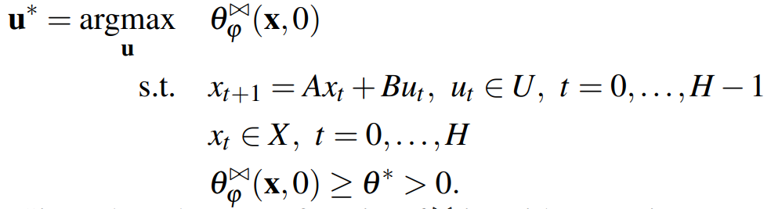
Time Robust STL Control Synthesis (Controller)
θ∗ : lower bound on time robustness
Gradient-based solvers ✘ (neither continuous nor smooth)
Monte-Carlo optimization ✘ (signal shifts)
Mixed-Integer Linear Programming (MILP) ✔
Explicitly encode the signal shifts

Slide 14

MILP Encoding of the problem

Slide 15

MILP Encoding Of Time Robustness (for STL Predicates)
Construct a binary variable $z_{t} ε \left\{0,1\right\}$ that corresponds to Boolean satisfaction of the predicate p by the trajectory at each time t = 0,….,H i.e. $z_{t}=1 if μ\left(x_{t}\right)≥0$
$z_{t}$ can be defined by the MILP predicates given by:
$$m\left(1−z_{t}\right)≤μ\left(x_{t}\right)≤\left(M+ε\right)z_{t} −ε$$
Where $ε$ is a small positive constant that represents tolerance
M = $\max_{xεX}{μ(x)}$ and m = $\min_{xεX}{μ(x)}$
Since $z_{t}=1 if μ\left(x_{t}\right)≥0$, the characteristic function is encoded as:
$$χ_{p}\left(x, t\right)=sign μ\left(x_{t}\right)=2z_{t}−1$$

Slide 16
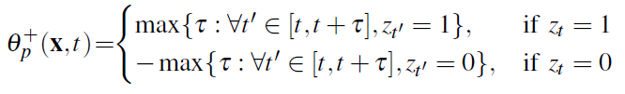

MILP Encoding Of Time Robustness (for STL Predicates)
From the definition of right time robustness, we can write:
This means that, if at point $z_{t}=1$, count the number of sequential $z_{t^{′}}=1$ where $t^{′}>t$ in order to calculate $θ_{p}^{+}\left(x,t\right)$
Similarly, if $z_{t}=0$, then count the number of 0s to the right and multiply the value by -1

Slide 17
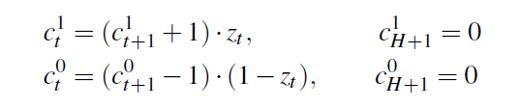
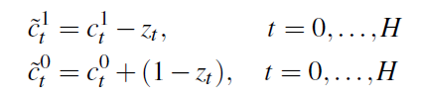

MILP Encoding Of Time Robustness (for STL Predicates)
Define the counter variables as:
The counters are defined backwards and are of length H+2
Time robustness is defined by the sequential $z_{t^{′}}$ when $t^{′}>t$ not $t^{′}≥t$. Hence, the counters must be modified as:

Slide 18
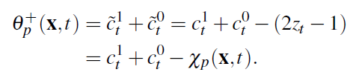

MILP Encoding Of Time Robustness (for STL Predicates)
Since the case of $z_{t}=0$ and $z_{t}=1$ are disjoint, the right time robustness can be defined as:
Thus, using the counter variables, the MILP encoding of the right time robustness is done

Slide 19
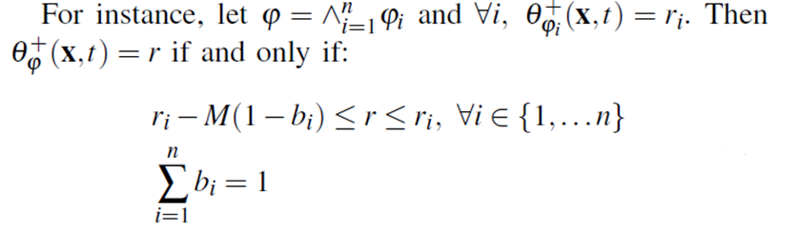
MILP Encoding Of STL operators
The MILP encoding of the STL operators is based on the paper
V. Raman, A. Donz´e, M. Maasoumy, R. M. Murray, A. Sangiovanni- Vincentelli, and S. A. Seshia. Model predictive control with signal temporal logic specifications. In 53rd IEEE Conference on Decision and Control, pages 81-87. IEEE, 2014.

Slide 20
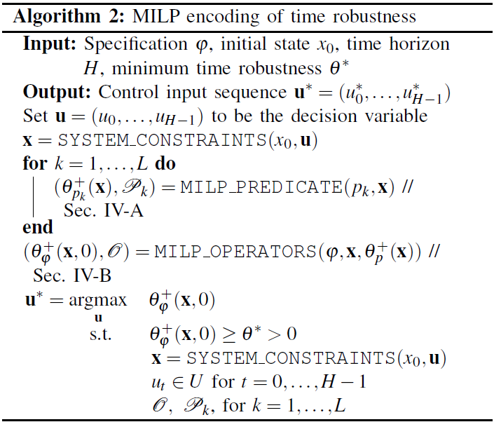
Algorithm for MILP encoding of time robustness

Slide 21
Results

Slide 22




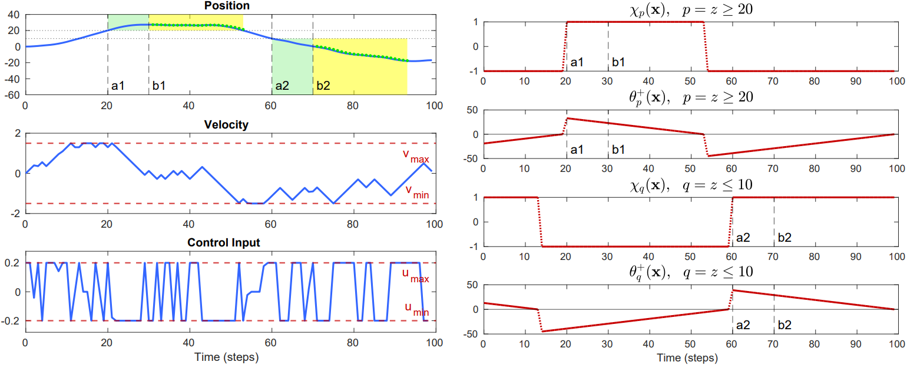
Results (2D UAV)

Slide 23

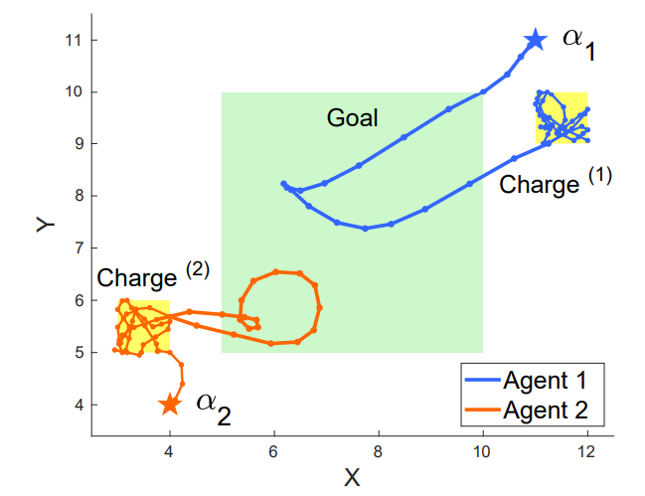
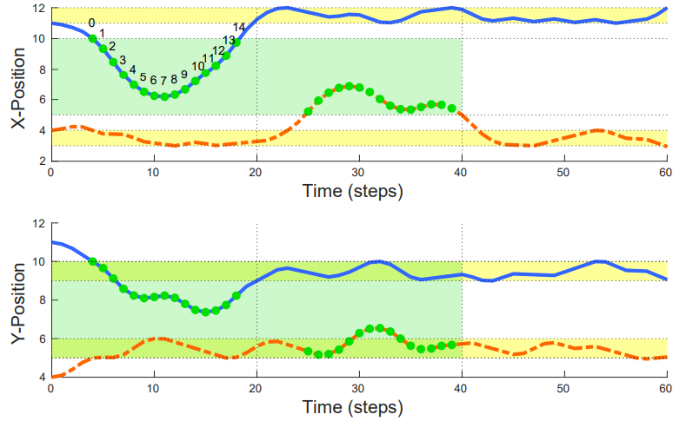
Results (Multi Agent Surveillance)
Goal region to be visited by at least one of the agents within the first 20 time steps and then within the next 20 time steps

Slide 24
Extension (Our Work)

Slide 25
Results (Multi Agent 3D UAV)
N_states = 24
N_control = 8
H = 50
Specification: Reach goal region always within the last 10 time steps
Solver Time (secs) = 44
Time Rob. = 1

Slide 26
Comparison (Multi Agent 3D UAV)
Time Robust Control
Convex MPC
Solver Time (secs) = 44
Time Rob. = 1
Jerky Trajectory!
Solver Time (secs) = 0.01
No notion of Time Rob.
Smooth Trajectory!

Slide 27
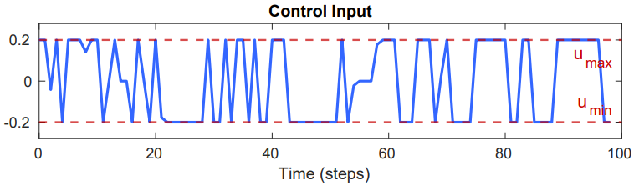
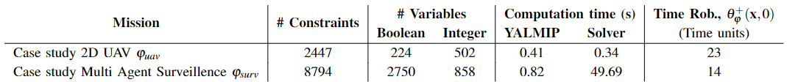
Problems
Control Inputs are abrupt
Computational time is very high
Cannot run online

Slide 28
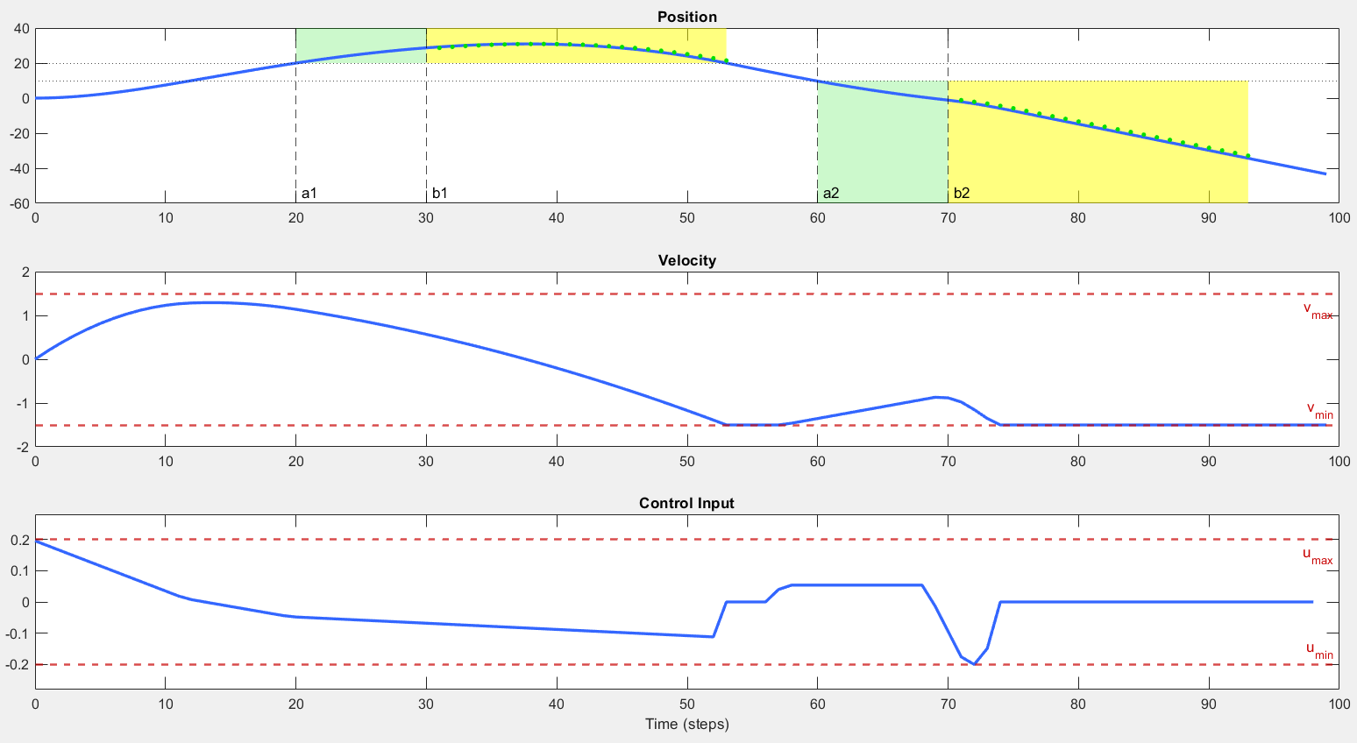
Solution for 1)
Perform regularization of inputs
Add the term u^{T} R u to the objective
2D UAV eg.
R = 0.001
Solver (sec) = 3.48
Right Time Rob. = 23
Same as before!

Slide 29
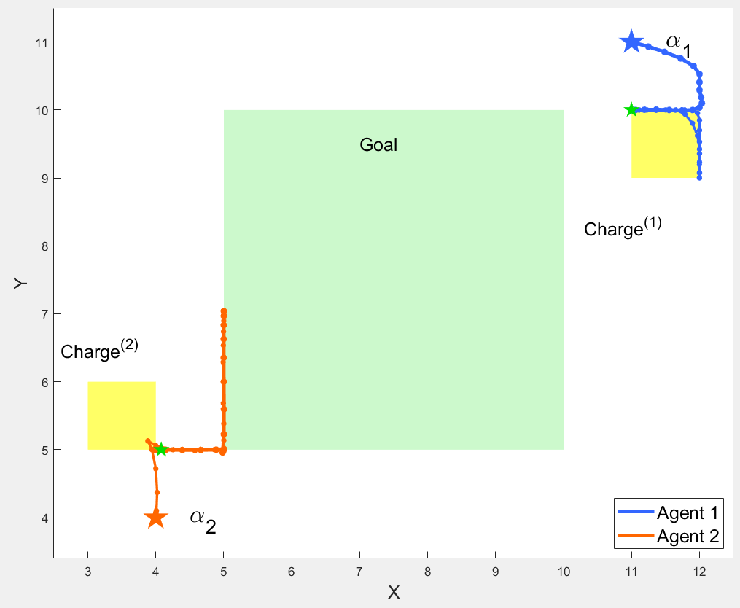
Solution for 1)
Multi agent surveillence eg.
R = 0.001
Solver (sec) = 240 (after max limit)
Right Time Rob. = 0
Decreased!
Can we do better by encouraging exploration?

Slide 30
Solution for 1)
Multi agent 3D UAV eg.
R = 1e-10
Solver (sec) = 139
Right Time Rob. = 0
Decreased!
Previous case

Slide 31

Thank You

Slide 32
References
O. Maler and D. Nickovic. Monitoring temporal properties of continuous signals. In Formal Techniques, Modelling and Analysis of Timed and Fault-Tolerant Systems, pages 152–166. Springer, 2004
G. Fainekos and G. Pappas. Robustness of temporal logic specifications for continuous-time signals. Theoretical Computer Science, 2009
T. Akazaki and I. Hasuo. Time robustness in MTL and expressivity in hybrid system falsification. In International Conference on Computer Aided Verification, pages 356–374. Springer, 2015
V. Raman, A. Donz´e, M. Maasoumy, R. M. Murray, A. Sangiovanni- Vincentelli, and S. A. Seshia. Model predictive control with signal temporal logic specifications. In 53rd IEEE Conference on Decision and Control, pages 81-87. IEEE, 2014.

Slide 33
Some Related Work
The real-time temporal logic STL, introduced in [1], is interpreted over real-valued continuous-time signals.
Authors in [2] define the robustness degree as a tube around a signal in which all signals either satisfy or violate the specification at hand (space robustness).
Many other space robustness notions have been proposed till now
Alternatively, [3] proposes averaged STL and captures a form of time robustness by averaging over time intervals and assigning priorities

